Slide 1
Challenges and solutions for sharing large-scale human genetic and phenotype data for research
Mallory Freeberg
3 June 2019

Slide 2
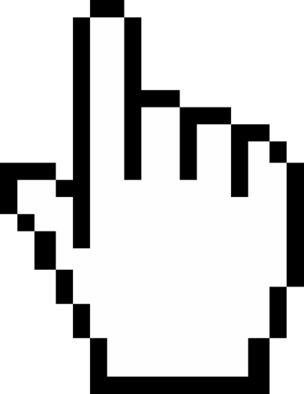



Sharing large-scale human genetic and phenotype data has many challenges
Data standards
Data privacy and access
Data transfer and storage

Slide 3
Challenges around data standards
Ensuring data are high quality Solution: Establish quality control metrics, assess data using metrics, [blacklist data not meeting standard].
Making data findable and reusable Solution: Describe data using metadata standard that exploits ontologies. Solution: Associate data with appropriate accessions.
Supporting data interoperability Solution: Follow community standards for data & metadata file formats. Solution: Support compatibility of systems and applications

Slide 4
Challenges around data privacy and access
Controlling who has access to data Solution: Coordinate with data generators and relevant legal teams to assess adherence to GDPR regulations. Solution: Implement authorization and authentication strategies.
Making data accessible to data consumers Solution: Perform user experience testing to understand how users want to consume data. Reassess periodically. Solution: Provide support and tooling for consumers to search for, browse, and download data.
Protecting individual (patient) privacy Solution: Ensuring data are pseudo-anonymized and/or de-identified**

Slide 5
Challenges around data storage and transfer
Transferring large amount of data into and out of storage system Solution: Coordinate with data generation and data storage teams to identify data transfer requirements and limitations. Solution: Provide tooling to satisfy consumer requirements for data download. Solution: Perform data integrity checks when transferring (e.g. checksums).
Ensuring persistence of data over time Solution: Store data in established archive with appropriate accessions, and perform data back ups and/or syncing to alternate infrastructure.
Scaling for the future (data volume) Solution: Establish infrastructure today that can support future scaling requirements

Slide 6
Sharing large-scale human genetic and phenotype data has many challenges solutions!
Data standards High-quality, FAIR data
Data privacy and access Controlled, anonymized, accessible data
Data transfer and storage Scaling solutions for consumer needs

